Slide 1
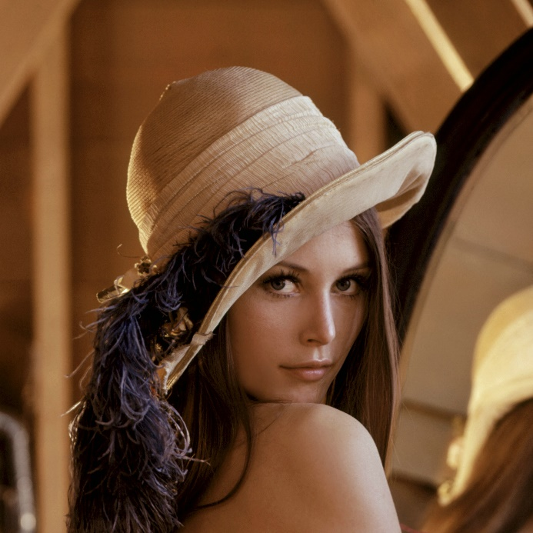


Visión por computador en la nueva era de la Inteligencia Artificial y el Deep Learning
Computer vision in the new era of Artificial Intelligence and Deep Learning
Rubén Usamentiaga*, Alberto Fernándezº
* University of Oviedo
º TSK
Gijón (Spain)
5 – 16 April 2021
https://github.com/albertofernandezvillan/computer-vision-and-deep-learning-course

Slide 2


TensorFlow and Keras
Introduction to TensorFlow and Keras
keras_applications_prediction.ipynb
set_up_kaggle_api_in_colab.ipynb
keras_applications_feature_extraction_for_classification.ipynb
keras_applications_feature_extraction_for_clustering.ipynb
keras_imagedatagenerator_and_dataset_augmentation.ipynb
keras_applications_transfer_learning_dogs.ipynb
keras_applications_prediction.ipynb
set_up_kaggle_api_in_colab.ipynb
keras_applications_feature_extraction_for_classification.ipynb
keras_applications_feature_extraction_for_clustering.ipynb
keras_imagedatagenerator_and_dataset_augmentation.ipynb
keras_applications_transfer_learning_dogs.ipynb
https://github.com/albertofernandezvillan/computer-vision-and-deep-learning-course
Notes:
Empezar con el ejemplo del tren en la pizarra

Slide 3
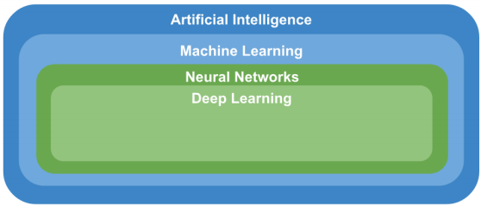
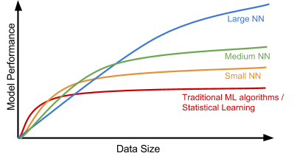
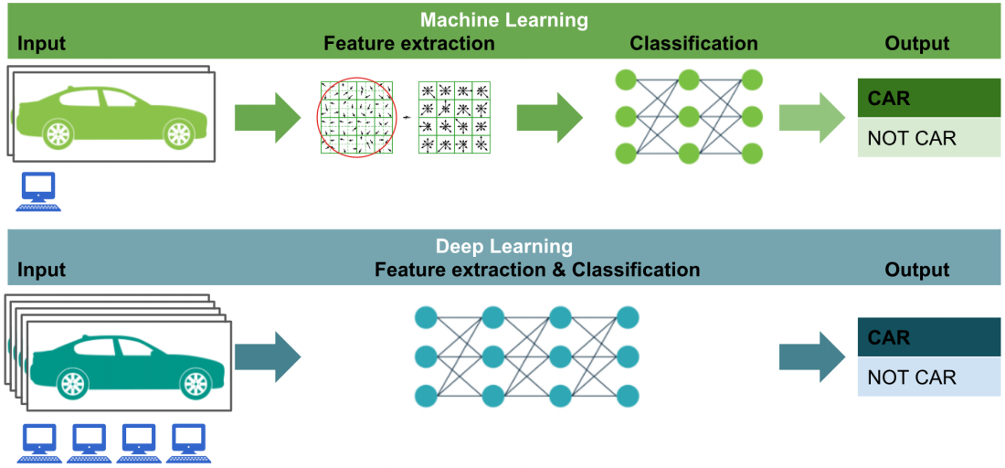
Machine learning vs deep learning

Slide 4

Deep learning frameworks
Deep learning frameworks introduced in this course

Slide 5
Introduction to Keras
Models API
Layers API
Callbacks API
Data preprocessing
Optimizers
Metrics
Losses
Built-in datasets
Keras Applications
Utilities
Different ways to create Keras models
API for creating layers and also using many built-in layers
Performing “actions” at various stages of training (e.g. At start or end of an epoch)
Transfor raw data on disk to a Dataset. Also other functions to work with images (e.g. load an image into PIL format)
Different available optimizers (e.g. SGD, RMSprop, Adam)
Many available metrics to judge the permormance of your model
Many available losses, which compute the quantity that a model should seek to minimize during training
Few toy datasets (already-vectorized, in Numpy format) that can be used for debugging a model or creating simple code examples. See also TensorFlow Datasets
Deep learning models that are made available alongside pre-trained weights. These models can be used for prediction, feature extraction, and fine-tuning
Many utilities for: 1) model plotting, 2) serialization, 3) Python, …

Slide 6
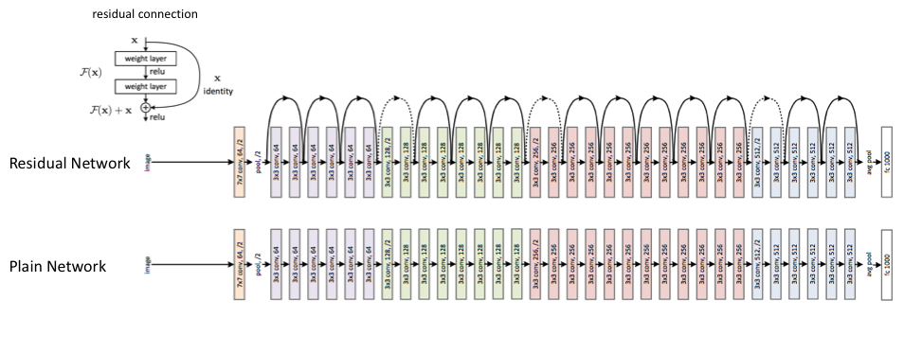
Introduction to Keras Applications
Keras Applications: Keras Applications are deep learning models that are made available alongside pre-trained weights. These models can be used for 1) prediction, 2) feature extraction, and 3) fine-tuning.
Example for prediction
from tensorflow.keras.applications.resnet50 import ResNet50
Instantiates the ResNet50 architecture with the weights pre-trained on ImageNet (note that include_top is True by default)
model = ResNet50(weights='imagenet')

Slide 7
Introduction to Keras Applications
Example for prediction
from tensorflow.keras.applications.resnet50 import ResNet50
from tensorflow.keras.preprocessing import image
from tensorflow.keras.applications.resnet50 import preprocess_input, decode_predictions
model = ResNet50(weights='imagenet')
Instantiates the ResNet50 architecture with the weights pre-trained on ImageNet (note that include_top is True by default
img_loaded = image.load_img(IMG_NAME, target_size=(224, 224))
Load the image (PIL format)
x = image.img_to_array(img_loaded)
x = np.expand_dims(x, axis=0)
x = preprocess_input(x)
Converts a PIL Image instance to a NumPy array
Shape: (1, 224, 224, 3)
The images are converted from RGB to BGR, then each color channel is zero-centered
preds = model.predict(x)
Get the predictions
decoded_preds = decode_predictions(preds, top=3)[0]
decode the results into a list of tuples (class, description, probability)

Slide 8
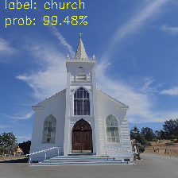
Introduction to Keras Applications
Example for prediction
from tensorflow.keras.applications.resnet50 import ResNet50
from tensorflow.keras.preprocessing import image
from tensorflow.keras.applications.resnet50 import preprocess_input, decode_predictions
model = ResNet50(weights='imagenet')
Instantiates the ResNet50 architecture with the weights pre-trained on ImageNet (note that include_top is True by default
img_loaded = image.load_img(IMG_NAME, target_size=(224, 224))
Load the image (PIL format)
x = image.img_to_array(img_loaded)
x = np.expand_dims(x, axis=0)
x = preprocess_input(x)
Converts a PIL Image instance to a NumPy array
Shape: (1, 224, 224, 3)
The images are converted from RGB to BGR, then each color channel is zero-centered
preds = model.predict(x)
Get the predictions
decoded_preds = decode_predictions(preds, top=3)[0]
decode the results into a list of tuples (class, description, probability)

Slide 9
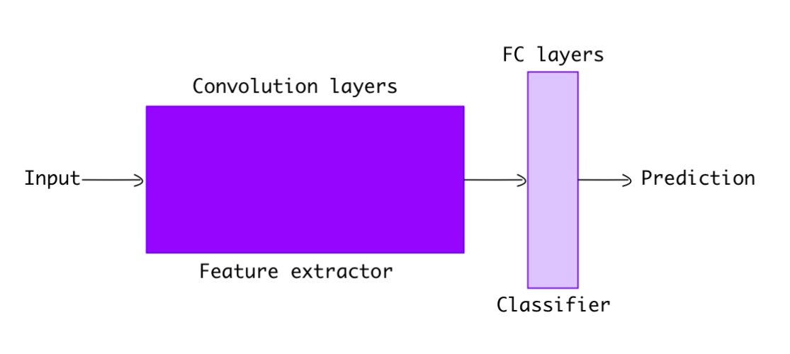
Introduction to Keras Applications
Example for feature extraction in a classification problem
Convolution layers extract features from the image
Fully connected layers classify the image using extracted features.
include_top parameter when instanciating the model indicates if including (True) or not including (False) the fully connected layers at the top of the network

Slide 10

Introduction to Keras Applications
Example for feature extraction in a classification problem
VGG16
tf.keras.applications.VGG16(
include_top=True,
weights="imagenet",
input_tensor=None,
input_shape=None,
pooling=None,
classes=1000,
classifier_activation="softmax")

Slide 11
Introduction to Keras Applications
Example for feature extraction in a classification problem
VGG16
We will use the first one. See the notebook for more information
model = VGG16(weights="imagenet", include_top=False, input_shape=(224, 224, 3))
Output from block5_pool (MaxPooling2D): (None, 7, 7, 512)
model_2 = VGG16(weights="imagenet", include_top=False, input_shape=(112, 112, 3))
Output from block5_pool (MaxPooling2D) (None, 3, 3, 512)
model_pooling = VGG16(weights="imagenet", include_top=False, input_shape=(224, 224, 3), pooling='max')
Output from global_max_pooling2d (GlobalMaxPooling2D) (None, 512)
model_2_pooling = VGG16(weights="imagenet", include_top=False, input_shape=(112, 112, 3), pooling='max')
Output from global_max_pooling2d_1 (GlobalMaxPooling2D) (None, 512)
model_flatten = tf.keras.models.Sequential()
model_flatten.add(VGG16(weights="imagenet", include_top=False),input_shape=(224, 224, 3))
model_flatten.add(tf.keras.layers.Flatten())
Output from flatten: (None, 25088)

Slide 12
Introduction to Keras Applications
Example for feature extraction in a classification problem
VGG16
model = VGG16(weights="imagenet", include_top=False, input_shape=(224, 224, 3))
Output from block5_pool (MaxPooling2D): (None, 7, 7, 512)
import numpy as np
def get_features(path_image):
img = load_img(path_image, target_size=(224, 224))
img = img_to_array(img)
img = np.expand_dims(img, axis=0)
img = preprocess_input(img)
vgg16_feats= model.predict(img)
vgg16_feats_flat = vgg16_feats.flatten()
return vgg16_feats_flat
For each image, this function returns a flatten array with a shape of (25088,)

Slide 13
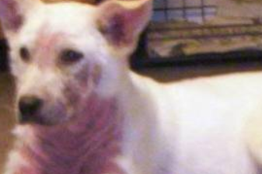
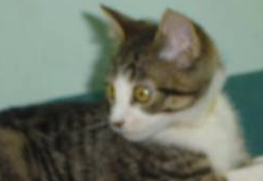
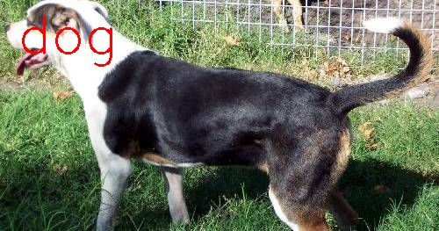
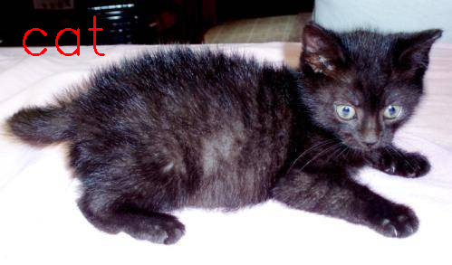
Introduction to Keras Applications
Example for feature extraction in a classification problem
vgg16_feature_list = []
labels = []
for each image:
features = get_features(path_image)
vgg16_feature_list.append(features)
labels.append(class_name)
vgg16_feature_list_np = np.array(vgg16_feature_list) #(200,25088)
labels_np = np.array(labels) #(200,)
N_DOGS = 100
from sklearn.linear_model import LogisticRegression
log_reg_model = LogisticRegression()
log_reg_model.fit(vgg16_feature_list_np, labels_np)
label = log_reg_model.predict(get_features(path_image).reshape(1,-1))[0]
N_CATS = 100

Slide 14
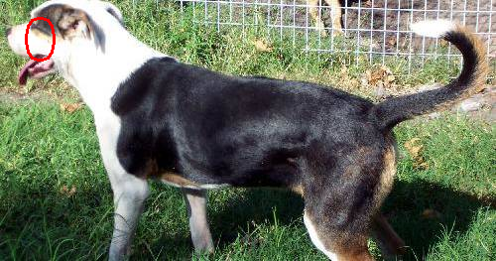
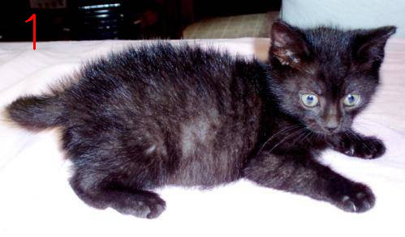
Introduction to Keras Applications
Example for feature extraction in a clustering problem
vgg16_feature_list = []
labels = []
for each image:
features = get_features(path_image)
vgg16_feature_list.append(features)
labels.append(class_name)
vgg16_feature_list_np = np.array(vgg16_feature_list) #(200,25088)
labels_np = np.array(labels) #(200,)
N_DOGS = 100
from sklearn.cluster import KMeans
kmeans = KMeans(n_clusters=2, random_state=0)
Kmeans. fit(vgg16_feature_list_np)
label = log_reg_model.predict(get_features(path_image).reshape(1,-1))[0]
N_CATS = 100

Slide 15
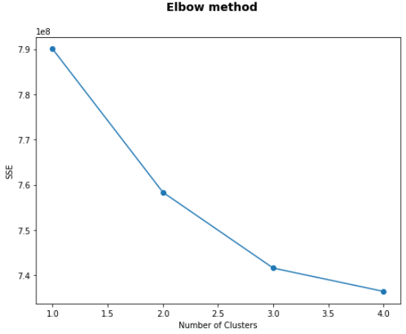
Introduction to Keras Applications
Example for feature extraction in a clustering problem
vgg16_feature_list = []
labels = []
for each image:
features = get_features(path_image)
vgg16_feature_list.append(features)
labels.append(class_name)
elbow method (see notebook)
vgg16_feature_list_np = np.array(vgg16_feature_list) #(200,25088)
labels_np = np.array(labels) #(200,)
N_DOGS = 100
from sklearn.cluster import KMeans
kmeans = KMeans(n_clusters=2, random_state=0)
Kmeans. fit(vgg16_feature_list_np)
label = log_reg_model.predict(get_features(path_image).reshape(1,-1))[0]
N_CATS = 100

Slide 16
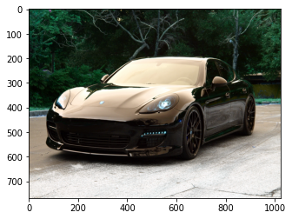
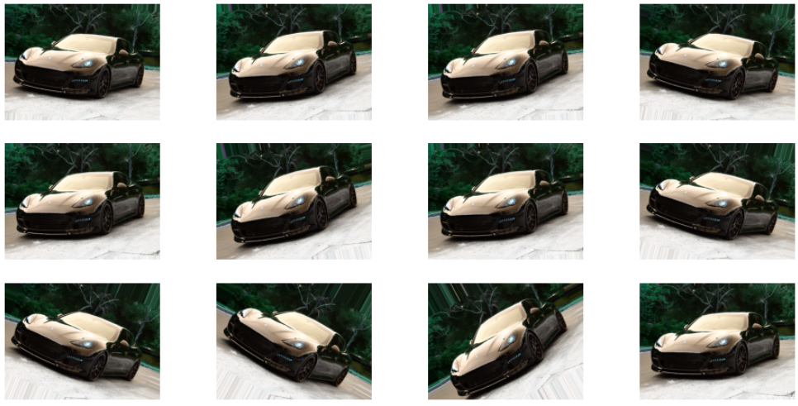
Data augmentation
https://www.tensorflow.org/api_docs/python/tf/keras/preprocessing/image/ImageDataGenerator
import tensorflow as tf
data_generator = tf.keras.preprocessing.image.ImageDataGenerator(rotation_range=30)
image_iterator = data_generator.flow(images)
show_augs(image_iterator)

Slide 17
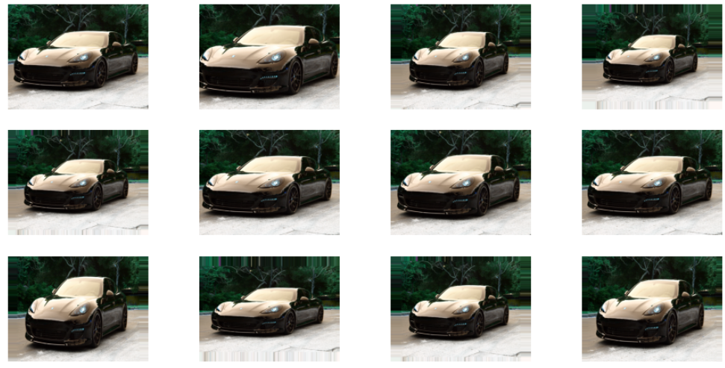
Data augmentation
https://www.tensorflow.org/api_docs/python/tf/keras/preprocessing/image/ImageDataGenerator
import tensorflow as tf
data_generator = tf.keras.preprocessing.image.ImageDataGenerator(zoom_range=0.25)
image_iterator = data_generator.flow(images)
show_augs(image_iterator)

Slide 18
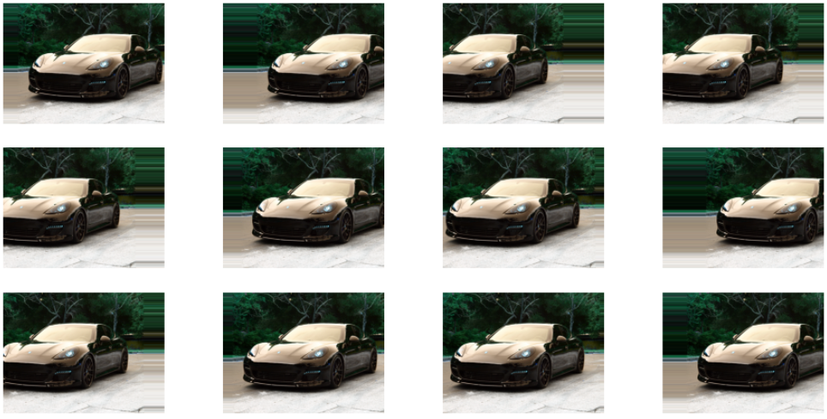
Data augmentation
https://www.tensorflow.org/api_docs/python/tf/keras/preprocessing/image/ImageDataGenerator
import tensorflow as tf
data_generator = tf.keras.preprocessing.image.ImageDataGenerator(width_shift_range=0.3)
image_iterator = data_generator.flow(images)
show_augs(image_iterator)

Slide 19
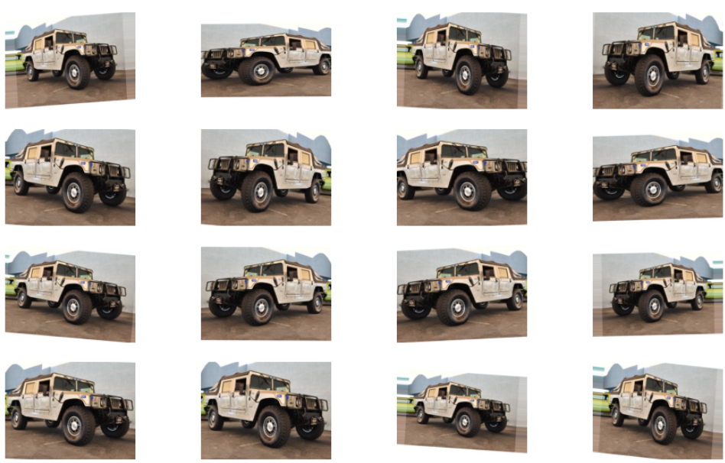
Data augmentation
data_generator = tf.keras.preprocessing.image.ImageDataGenerator(
rescale=1. / 255,
zoom_range=0.2,
rotation_range = 5,
horizontal_flip=True)

Slide 20
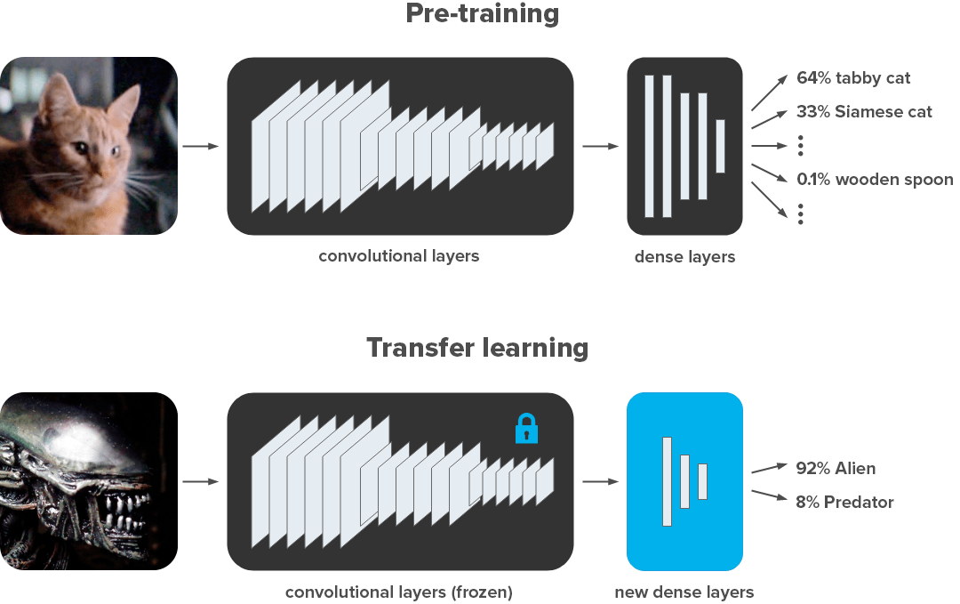
Introduction to Keras Applications
Example for transfer learning
Image taken from here
Multiclass classification
Binary classification

Slide 21

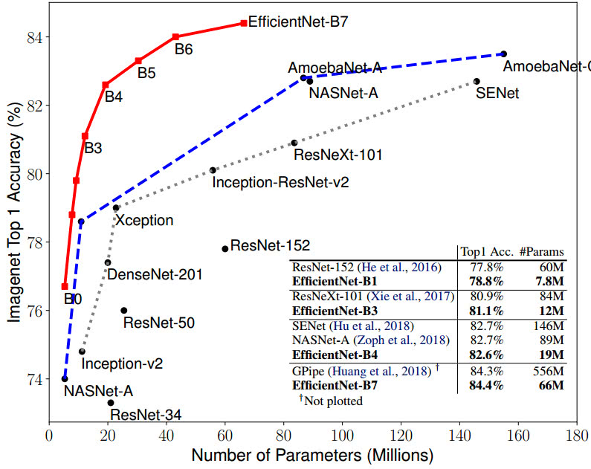
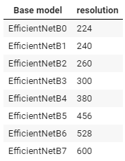
Introduction to Keras Applications
Example for transfer learning

Slide 22
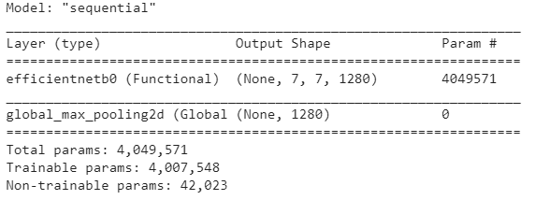
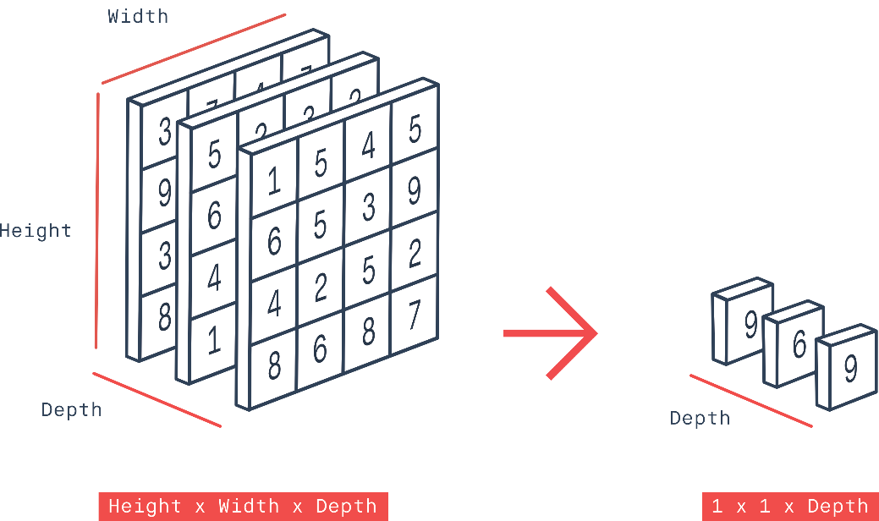
Introduction to Keras Applications
from tensorflow.keras.applications import EfficientNetB0
base_model_eff = EfficientNetB0(include_top=False, input_shape=(INPUT_SHAPE[0], INPUT_SHAPE[1], 3), weights="imagenet")
output is a 4D tensor
(None, 7, 7, 1280)
base_model_eff = EfficientNetB0(include_top=False, input_shape=(INPUT_SHAPE[0], INPUT_SHAPE[1], 3), weights="imagenet")
model = models.Sequential()
model.add(base_model_eff)
model.add(layers.GlobalMaxPooling2D())
model.summary()
GlobalMaxPooling2D() results in a much smaller number of features compared to the Flatten()layer
output is a 2D tensor
(None, 1280)
tf.keras.layers.GlobalMaxPool2D()
#(batch_size, rows, cols, channels)
input_shape = (1, 3, 3, 3)
x = tf.random.normal(input_shape)
y = tf.keras.layers.GlobalMaxPool2D()(x)
#(batch_size, channels)
print(y.shape) # (1, 3)
See the notebook for more information

Slide 23
TensorFlow and Keras
Introduction to TensorFlow and Keras
https://github.com/albertofernandezvillan/computer-vision-and-deep-learning-course
Notes:
Empezar con el ejemplo del tren en la pizarra

